Slide 1


Chapter 3 Digital Logic Structures
An Hong han@ustc.edu.cn
2019 Fall
Lecture on
Introduction to Computing Systems
（01170401）
School of Computer Science and Technology

Slide 2
Review
How do we represent data in a computer?
  Bits: 0/1
  Data type: representation and operations within the computer
    Integer Data Types
      Unsigned Integers
      2’Complement Integers
    Fixed-Point Data Types
    Floating-Point Data Types
    Text – characters, strings, …
    Images – pixels, colors, shapes, …
    Sound
    Instructions
    ……
  Arithmetic and Logical Operations
  Binary-Decimal Conversion

Slide 3
Today
Microprocessors contain millions of transistors
  Intel Core 2 Duo: 291 million
  AMD Barcelona: 463 million
  IBM Power6: 790 million
Transistor: Building Block of Computers
  Logically, each transistor acts as a switch
Combined to implement logic functions
  AND, OR, NOT
Combined to build higher-level structures
  Adder, multiplexer, decoder, register, …
Combined to build processor
  LC-3

Slide 4
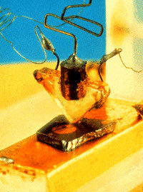
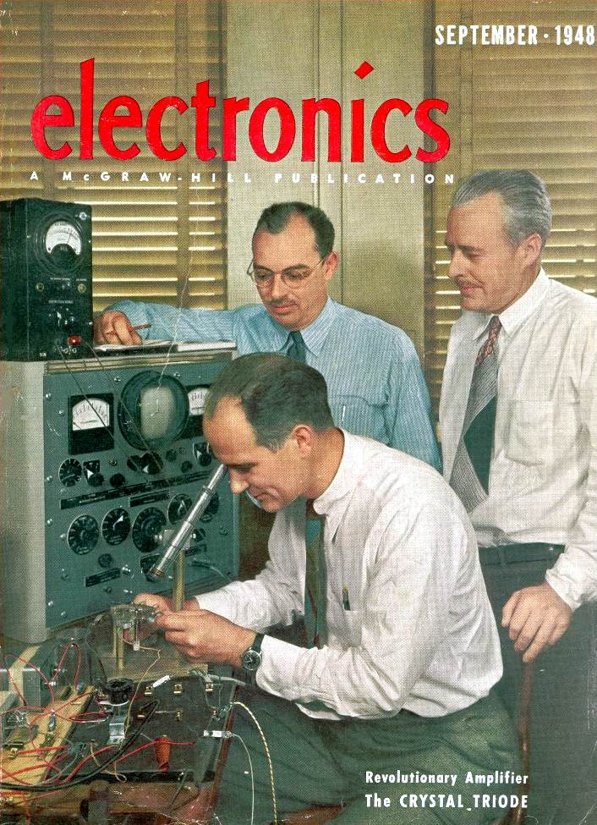
晶体管的发明
Bell Labs lays the groundwork:
1945: Bell sets up lab in the hopes of developing “solid state” components to replace existing electromechanical systems. William Schockley, John Bardeen, Walter Brattain: all solid-state physicists. Focus on Si and Ge.
1951: Shockley develops junction transistor which can be manufactured in quantity.
1954: The first transistor radio! Also, TI makes first silicon transistor (price $2.50)
1956: Bardeen, Shockley, Brattain receive Nobel Prize.

Slide 5
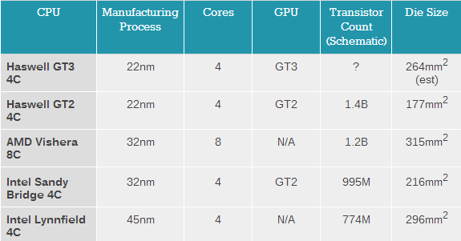
Microprocessors contain millions of transistors

Slide 6


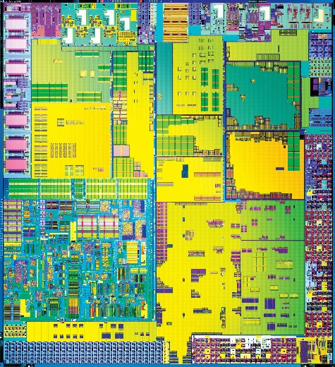
Microprocessors contain millions of transistors

Slide 7
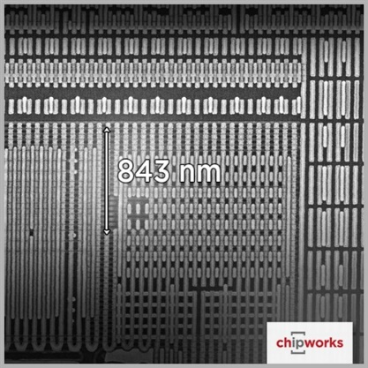
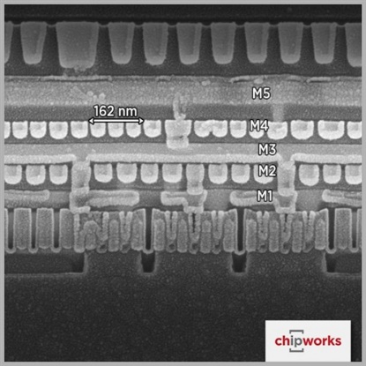
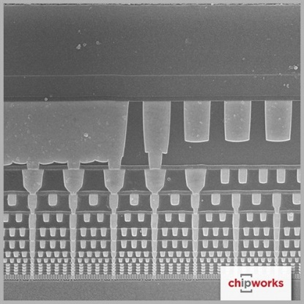
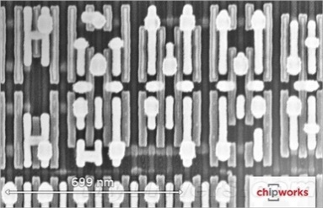
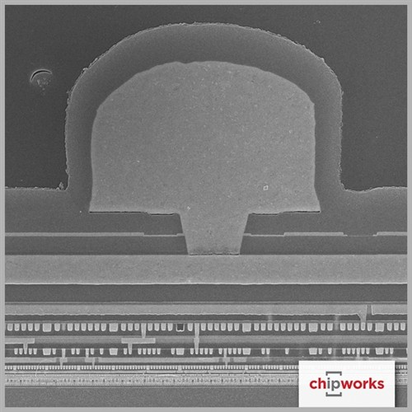
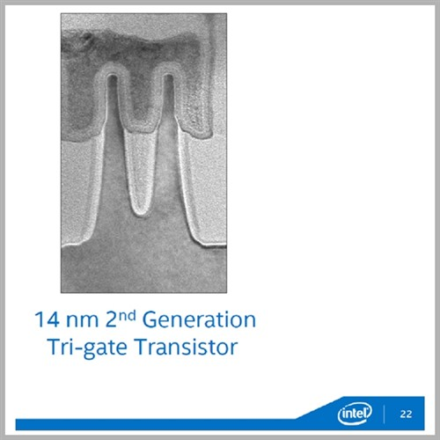
芯片里面有几千万的晶体管是怎么实现的？
http://www.zhihu.com/question/26998618
显微镜下的晶体管

Slide 8

Bottom up approach
Transistor
Now, You are Here.

Slide 9

Big Idea #2: How do we get the electrons to do the work?
Application
Algorithm & Data Structure
Language
Software
指令集体系结构 (Machine Architecture, ISA)
Hardware
Microarchiture
Logic and IC
Now, You are Here.
Device
Computer System: Layers of Abstraction
Notes:
9

Slide 10
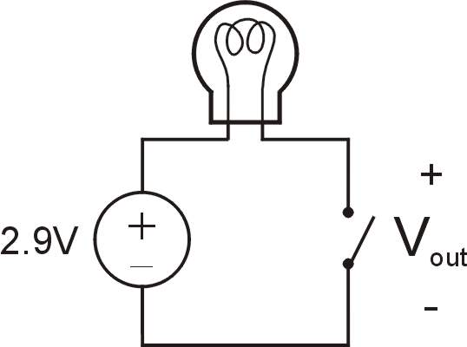
Simple Switch Circuit
Switch open:
  No current through circuit
  Light is off
  V_{out} is +2.9V
Switch closed:
  Short circuit across switch
  Current flows
  Light is on
  V_{out} is 0V
Switch-based circuits can easily represent two states:
on/off, open/closed, voltage/no voltage.
Notes:
10

Slide 11


N-type MOS Transistor
Gate = 1
Gate = 0
Terminal #2 must be
connected to GND (0V).
MOS = Metal Oxide Semiconductor
  two types: N-type and P-type
N-type
  when Gate has positive voltage,
  short circuit between #1 and #2
  (switch closed)
  when Gate has zero voltage,
  open circuit between #1 and #2
  (switch open)
Notes:
11

Slide 12
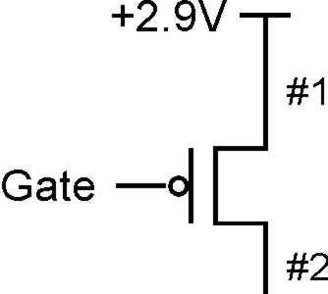
P-type MOS Transistor
Gate = 1
Gate = 0
Terminal #1 must be
connected to +2.9V.
P-type is complementary to N-type
  when Gate has positive voltage,
  open circuit between #1 and #2
  (switch open)
  when Gate has zero voltage,
  short circuit between #1 and #2
  (switch closed)
Notes:
12

Slide 13
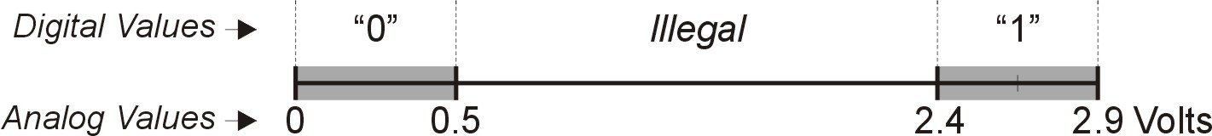
Logic Gates
Use switch behavior of MOS transistors
to implement logical functions: AND, OR, NOT.
Digital symbols:
  recall that we assign a range of analog voltages to each
  digital (logic) symbol
  assignment of voltage ranges depends on
  electrical properties of transistors being used
    typical values for "1": +5V, +3.3V, +2.9V, +1.1V
    for purposes of illustration, we'll use +2.9V

Slide 14
CMOS Circuit
Complementary MOS
Uses both N-type and P-type MOS transistors
  P-type
    Attached to + voltage
    Pulls output voltage UP when input is zero
  N-type
    Attached to GND
    Pulls output voltage DOWN when input is one
For all inputs, make sure that output is either connected to GND or to +,
but not both!

Slide 15
Bottom up approach
Transistor
Now, You are Here.

Slide 16
Big Idea #2: How do we get the electrons to do the work?
Application
Algorithm & Data Structure
Language
Software
指令集体系结构 (Machine Architecture, ISA)
Hardware
Microarchiture
Now, You are Here.
Logic and IC
Device
Computer System: Layers of Abstraction
Notes:
16

Slide 17
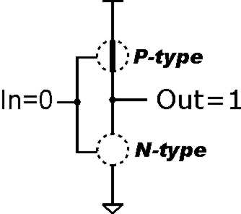
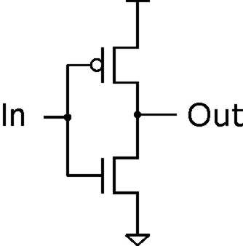
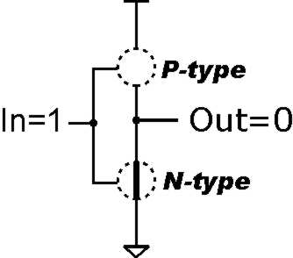
Inverter (NOT Gate)
2.9V
Truth table
0V
In | Out
0 V | 2.9 V
2.9 V | 0 V
In | Out
0 | 1
1 | 0
Notes:
17

Slide 18
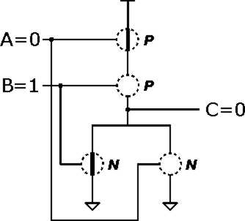
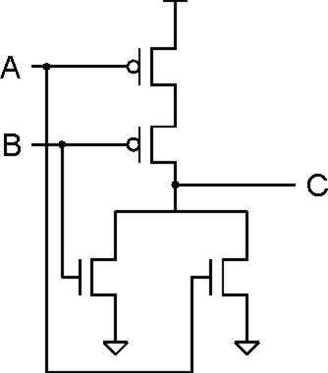
NOR Gate
A | B | C
0 | 0 | 1
0 | 1 | 0
1 | 0 | 0
1 | 1 | 0
Note: Serial structure on top, parallel on bottom.
Notes:
18

Slide 19
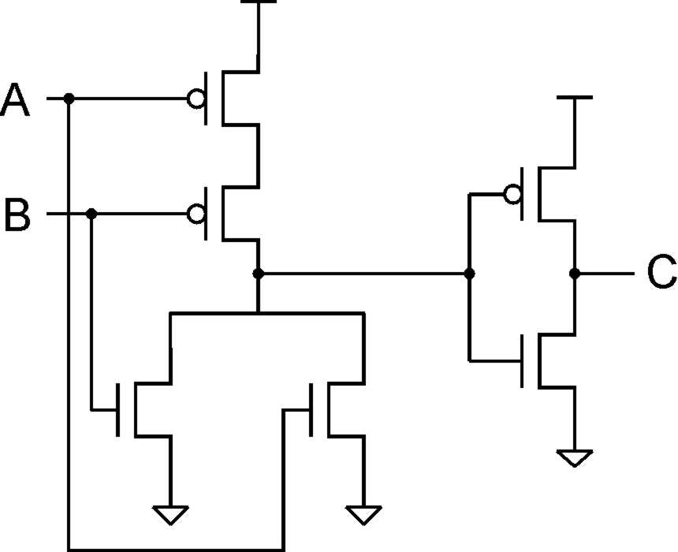
OR Gate
A | B | C
0 | 0 | 0
0 | 1 | 1
1 | 0 | 1
1 | 1 | 1
Add inverter to NOR.

Slide 20
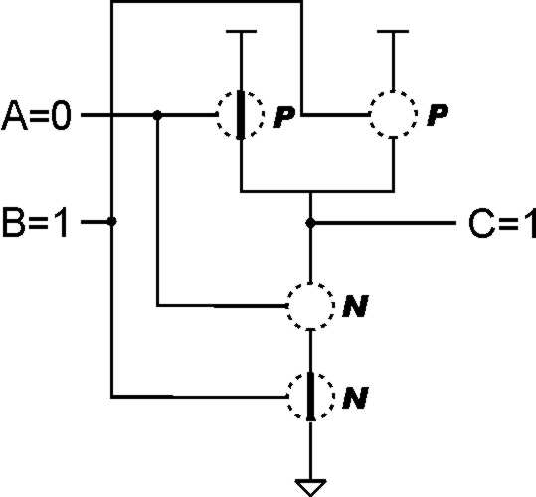
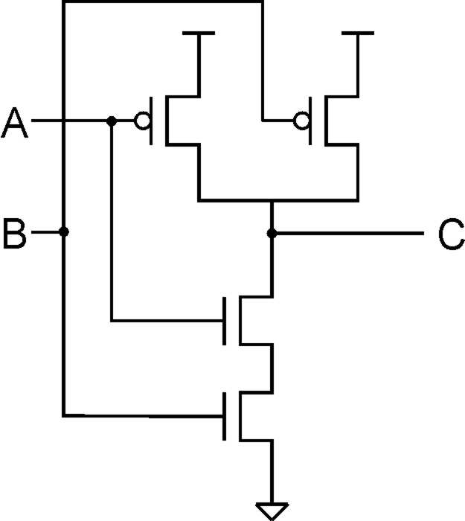
NAND Gate (AND-NOT)
A | B | C
0 | 0 | 1
0 | 1 | 1
1 | 0 | 1
1 | 1 | 0
Note: Parallel structure on top, serial on bottom.
Notes:
20

Slide 21
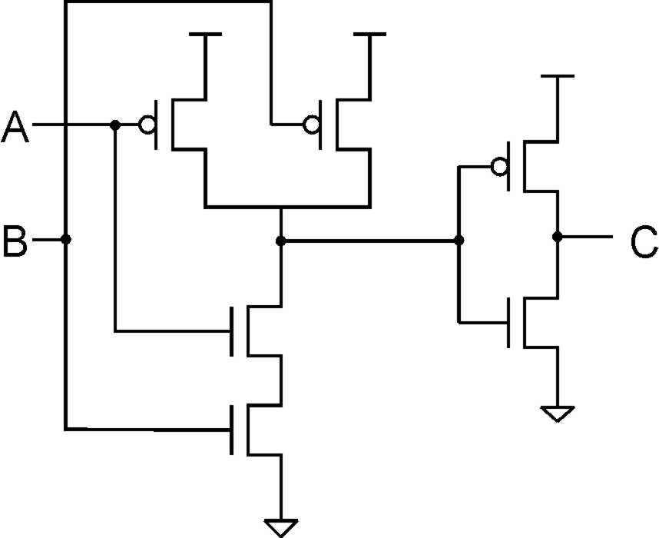
AND Gate
A | B | C
0 | 0 | 0
0 | 1 | 0
1 | 0 | 0
1 | 1 | 1
Add inverter to NAND.

Slide 22
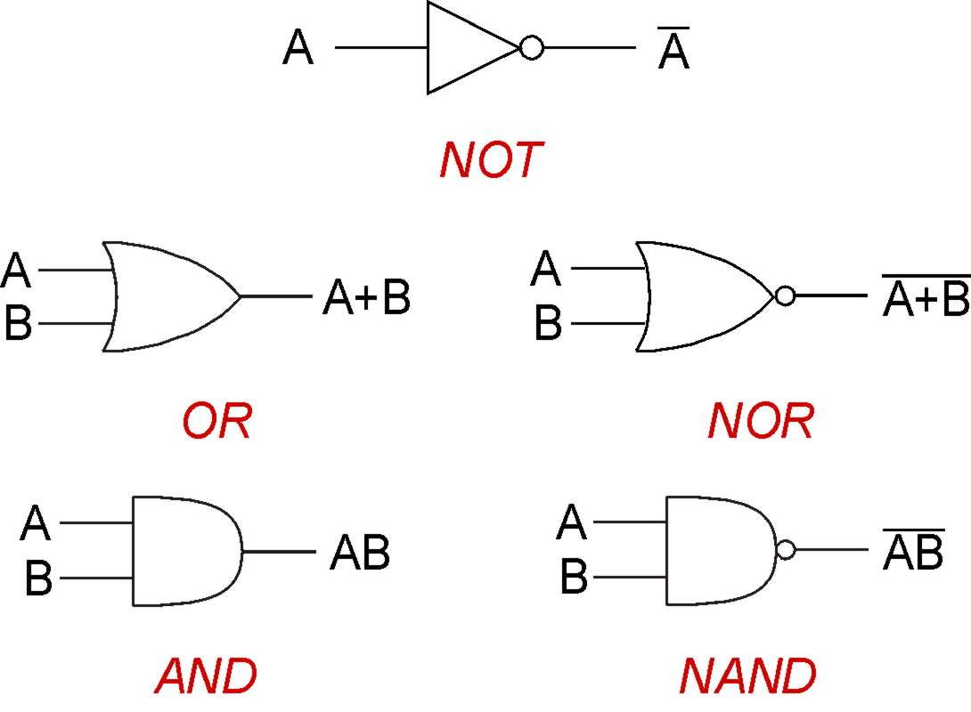
Basic Gates
From Now on……Gates
  Covered transistors mostly so that you know they exist
  Note: “Logic Gate” not related to “Gate” of transistors
Will study implementation in terms of gates
  Circuits that implement Boolean functions
More complicated gates from transistors possible
  • XOR, Multiple-input AND-OR-Invert (AOI) gates

Slide 23
Practice
Implement a 3-input NOR gate with CMOS.

Slide 24
Practice
A | B | C
0 | 0 | 0
0 | 1 | 1
1 | 0 | 1
1 | 1 | 0
Notes:
24
In ECE 352, you'll learn how to minimize logic functions -- to implement them with the fewest number of gates.

Slide 25
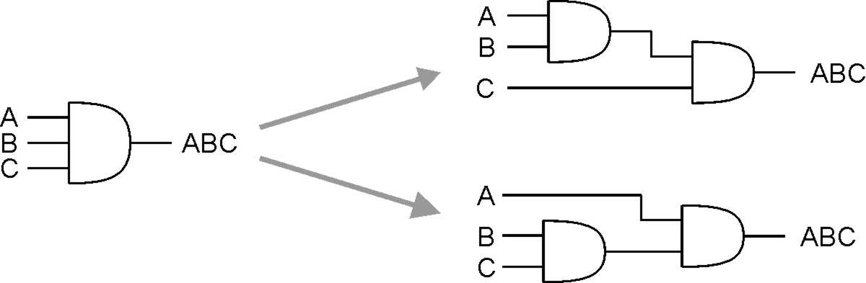
More than 2 Inputs?
AND/OR can take any number of inputs.
  AND = 1 if all inputs are 1.
  OR = 1 if any input is 1.
  Similar for NAND/NOR.
Can implement with multiple two-input gates,
or with single CMOS circuit.

Slide 26
Visual Shorthand for Multi-bit Gates
Use a cross-hatch mark to group wires
  Example: calculate the AND of a pair of 4-bit numbers
  A3 is “high-order” or “most-significant” bit
  If “A” is 1000, then A₃ = 1, A₂ = 0, A₁ = 0, A₀ = 0

Slide 27
Shorthand for Inverting Signals
Invert a signal by adding either
  A before/after a gate
  A “bar” over letter

Slide 28
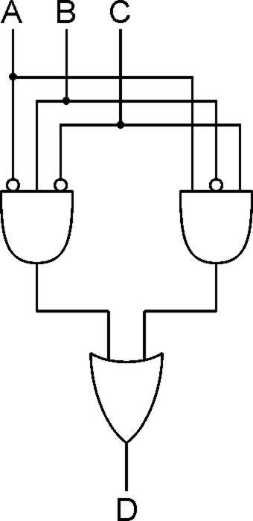
Logical Completeness
A | B | C | D
0 | 0 | 0 | 0
0 | 0 | 1 | 0
0 | 1 | 0 | 1
0 | 1 | 1 | 0
1 | 0 | 0 | 0
1 | 0 | 1 | 1
1 | 1 | 0 | 0
1 | 1 | 1 | 0
1. AND combinations
that yield a "1" in the
truth table.
2. OR the results
of the AND gates.
AND, OR, NOT can implement ANY truth table
Notes:
28
Note the use of the bubbles (NOT) in the input.

Slide 29
Logical Completeness
AND, OR, NOT can implement ANY truth table

Slide 30
DeMorgan's Law
Converting AND to OR (with some help from NOT)
Consider the following gate:
To convert AND to OR
(or vice versa),
invert inputs and output.
A | B
0 | 0 | 1 | 1 | 1 | 0
0 | 1 | 1 | 0 | 0 | 1
1 | 0 | 0 | 1 | 0 | 1
1 | 1 | 0 | 0 | 0 | 1
Same as A OR B!
Why might this be useful?
Notes:
30
If there's time, perhaps discuss how all gates can be implemented with NAND (or NOR).
Therefore, you can implement any truth table using only NAND (or NOR) gates.

Slide 31
Building Functions from Logic Gates
We've already seen how to implement truth tables
using AND, OR, and NOT -- an example of
combinational logic.
Combinational Logic Circuit
  output depends only on the current inputs
  stateless
Sequential Logic Circuit
  output depends on the sequence of inputs (past and present)
  stores information (state) from past inputs
We'll first look at some useful combinational circuits,
then show how to use sequential circuits to store information.

Slide 32
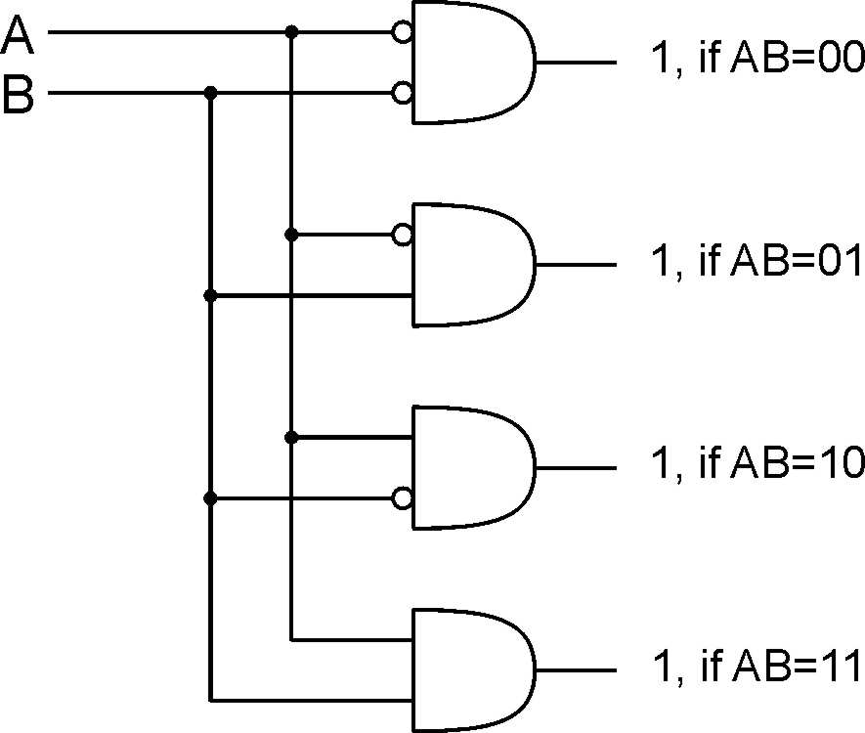
Decoder
2-bit
decoder
n inputs, 2^{n} outputs
  exactly one output is 1 for each possible input pattern
Notes:
32
Uses of decoder:
convert memory/register address to a control line that selects that location
convert an opcode to one of n control lines

Slide 33
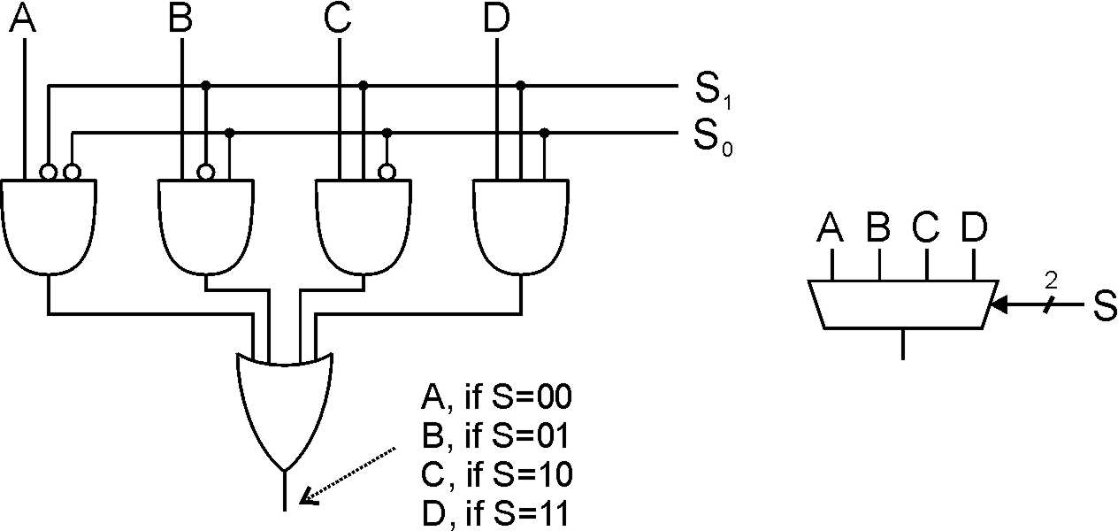
Multiplexer (MUX)
4-to-1 MUX
n-bit selector and 2^{n} inputs, one output
  output equals one of the inputs, depending on selector
Notes:
33
Another view: decode S, and AND each output with one of the MUX inputs.
Also explain multi-bit inputs.
Uses of multiplexer:
select which input to use for function
select which computed value to pass to next stage (or to place on bus)

Slide 34
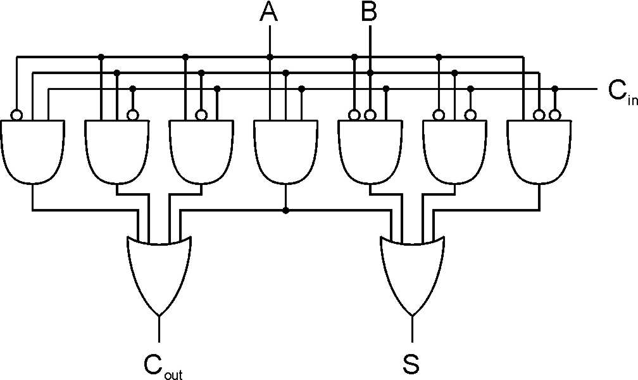
Full Adder
A | B | C_{in} | S | C_{out}
0 | 0 | 0 | 0 | 0
0 | 0 | 1 | 1 | 0
0 | 1 | 0 | 1 | 0
0 | 1 | 1 | 0 | 1
1 | 0 | 0 | 1 | 0
1 | 0 | 1 | 0 | 1
1 | 1 | 0 | 0 | 1
1 | 1 | 1 | 1 | 1
Add two bits and carry-in,
produce one-bit sum and carry-out.
Notes:
34
A half-adder is one that doesn't take a carry-in.
Sum is one when 1 or 3 inputs are one. Carry-out is one when 2 or 3 inputs are one.

Slide 35
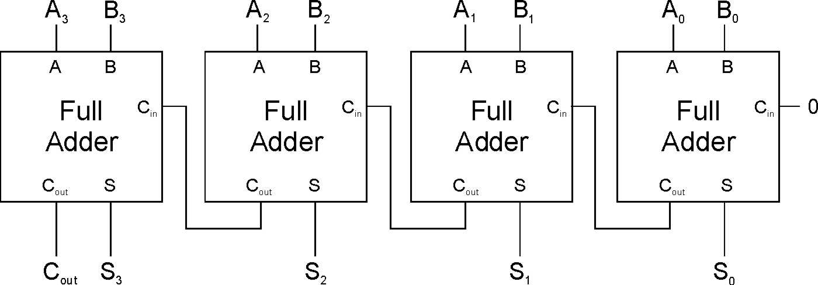
Four-bit Adder
Notes:
35
This is called a "ripple-carry" adder. The sum becomes valid as the carry ripples its way from the low bit to the high bit. How many gate delays until the output is settled?

Slide 36
Adder/Subtracter - Approach #1
A+B
A-B

Slide 37
Adder/Subtracter - Approach #2

Slide 38
Incrementer
Let’s create a incrementer
  Input: A (as a 16-bit 2’s complement integer)
  Output: A+1 (also as a 16-bit 2’s complement integer)
Approach #1 (impractical):
  Use PLA-like techniques to implement circuit
  Problem: 216 or 65536 rows, 16 output columns
  In theory, possible; in practice, intractable
Approach#2 (pragmatic):
  Create a 1-bit incrementer circuit
  Replicate it 16 times

Slide 39
One-bit Incrementer
Implement a single-column of an incrementer
A | C_{in} | S | C_{out}
0 | 0 | 0 | 0
0 | 1 | 1 | 0
1 | 0 | 1 | 0
1 | 1 | 0 | 1

Slide 40
Combinational vs. Sequential
Combinational Circuit
  always gives the same output for a given set of inputs
    ex: adder always generates sum and carry,
    regardless of previous inputs
Sequential Circuit
  stores information
  output depends on stored information (state) plus input
    so a given input might produce different outputs,
    depending on the stored information
  example: ticket counter
    advances when you push the button
    output depends on previous state
  useful for building “memory” elements and “state machines”
Notes:
40

Slide 41
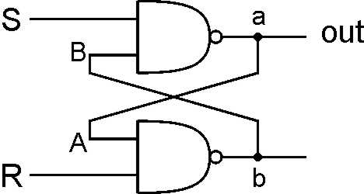
R-S Latch: Simple Storage Element
R is used to “reset” or “clear” the element – set it to zero.
S is used to “set” the element – set it to one.
If both R and S are one, out could be either zero or one.
  “quiescent” state -- holds its previous value
  note: if a is 1, b is 0, and vice versa
1
1
0
1
1
0
1
1
0
0
1
0
1
1

Slide 42
Clearing the R-S latch
1
0
1
1
1
0
0
Output changes to zero.
1
1
1
0
1
0
1
0
0
Then set R=1 to “store” value in quiescent state.
Suppose we start with output = 1, then change R to zero.
Notes:
42
Setting R to zero forces b (and B) to 1, which forces a (and A) to zero.
This is a stable state, because R=0 and A=0 means b=1.
Bring R back to one then keeps the output at zero.
What is the result if we start with a=0?

Slide 43
Setting the R-S Latch
1
1
0
0
1
Output changes to one.
1
0
0
1
1
0
1
Then set S=1 to “store” value in quiescent state.
Suppose we start with output = 0, then change S to zero.
Notes:
43
Setting S to zero forces a (and A) to 1, which forces b (and B) to zero.
This is a stable state, because S=0 and B=0 means a=1.
Bring S back to one then keeps the output at one.
What is the result if we start with a=1?

Slide 44
R-S Latch Summary
R = S = 1
  hold current value in latch
S = 0, R=1
  set value to 1
R = 0, S = 1
  set value to 0
R = S = 0
  both outputs equal one
  final state determined by electrical properties of gates
  Don’t do it!

Slide 45
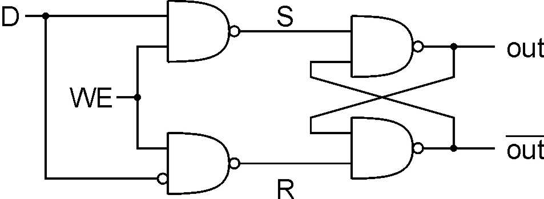
Gated D-Latch
Two inputs: D (data) and WE (write enable)
  when WE = 1, latch is set to value of D
    S = NOT(D), R = D
  when WE = 0, latch holds previous value
    S = R = 1
Notes:
45
The D-latch is used to store a single data bit. The latch is set to the value of D whenever WE=1; when WE=0, the current value is stored, no matter what D becomes.
Using D and not(D) to control S and R makes it easier to ensure that S and R are never zero at the same time.
WE allows us to control when a new value is written to the latch.

Slide 46
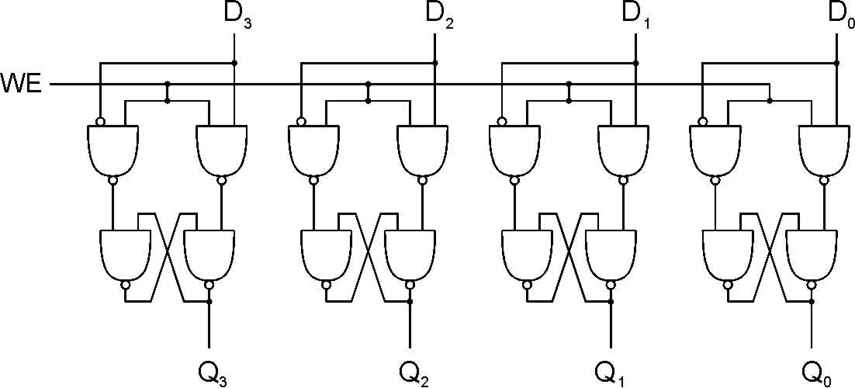
Register
A register stores a multi-bit value.
  We use a collection of D-latches, all controlled by a common WE.
  When WE=1, n-bit value D is written to register.

Slide 47
Representing Multi-bit Values
Number bits from right (0) to left (n-1)
  just a convention -- could be left to right, but must be consistent
Use brackets to denote range:
D[l:r] denotes bit l to bit r, from left to right
May also see A<14:9>,
especially in hardware block diagrams.
15
0
A = 0101001101010101
A[14:9] = 101001
A[2:0] = 101

Slide 48
Memory
Address Space:
number of locations
(usually a power of 2)
k = 2^{n}
locations
•
•
•
Addressability:
number of bits per location
(e.g., byte-addressable)
m bits
Now that we know how to store bits, we can build a memory – a logical k × m array of stored bits.

Slide 49
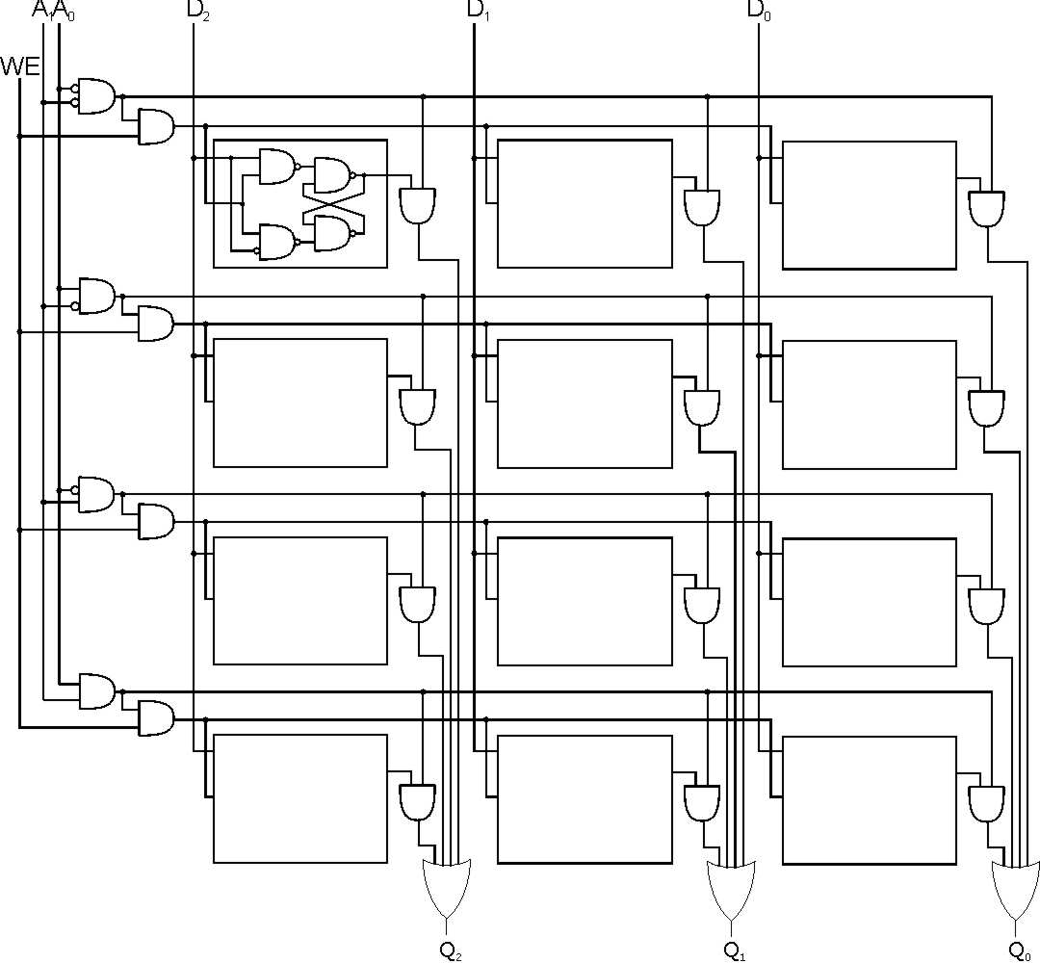
2² x 3 Memory
word select
word WE
input bits
address
write
enable
address
decoder
output bits
Notes:
49
Decoder asserts one of the word select lines, based on address.
Word select activates one of the output AND gates, which drives the selected data to the output OR gate. (For a read, this is basically a MUX -- decoder ANDed with signals, results ORed together.)
When writing, the only WE bits for the proper word are asserted (based on decoder again).

Slide 50
More Memory Details
This is a not the way actual memory is implemented.
  fewer transistors, much more dense,
  relies on electrical properties
But the logical structure is very similar.
  address decoder
  word select line
  word write enable
Two basic kinds of RAM (Random Access Memory)
  Static RAM (SRAM)
    fast, not very dense (bitcell is a latch)
  Dynamic RAM (DRAM)
    slower but denser, bit storage must be periodically refreshed
    each bitcell is a capacitor (like a leaky bucket) that decays
Also, non-volatile memories: ROM, PROM, flash, …

Slide 51
SRAM Memory
Memory Data In
Write bitlines
m
Read Address Decoder
WE
. . .
D
D
D
Memory Read Address
Write Address Decoder
Read word line
. . .
Memory WriteAddress
D
D
D
n
Write word line
. . .
n
. . .
. . .
. . .
D
D
D
Gated
D-latch
D
Q
Read bitlines
WE
m
Memory Data Out

Slide 52
State Machine
State Machine
Inputs
Combinational
Logic Circuit
Outputs
Storage
Elements
Another type of sequential circuit
  Combines combinational logic with storage
  “Remembers” state, and changes output (and state)
  based on inputs and current state

Slide 53
Combinational vs. Sequential
30
4
1
8
4
25
5
20
10
15
Combinational
Success depends only on
the values, not the order in
which they are set.
Sequential
Success depends on
the sequence of values
(e.g, R-13, L-22, R-3).
Two types of “combination” locks

Slide 54
State
The state of a system is a snapshot of all the relevant elements of the system at the moment the snapshot is taken.
Examples:
  The state of a basketball game can be represented by the scoreboard.
    Number of points, time remaining, possession, etc.
  The state of a tic-tac-toe game can be represented by the placement of X’s and O’s on the board.

Slide 55
State of Sequential Lock
Our lock example has four different states,
labelled A-D:
A: The lock is not open,
and no relevant operations have been performed.
B: The lock is not open,
and the user has completed the R-13 operation.
C: The lock is not open,
and the user has completed R-13, followed by L-22.
D: The lock is open.

Slide 56
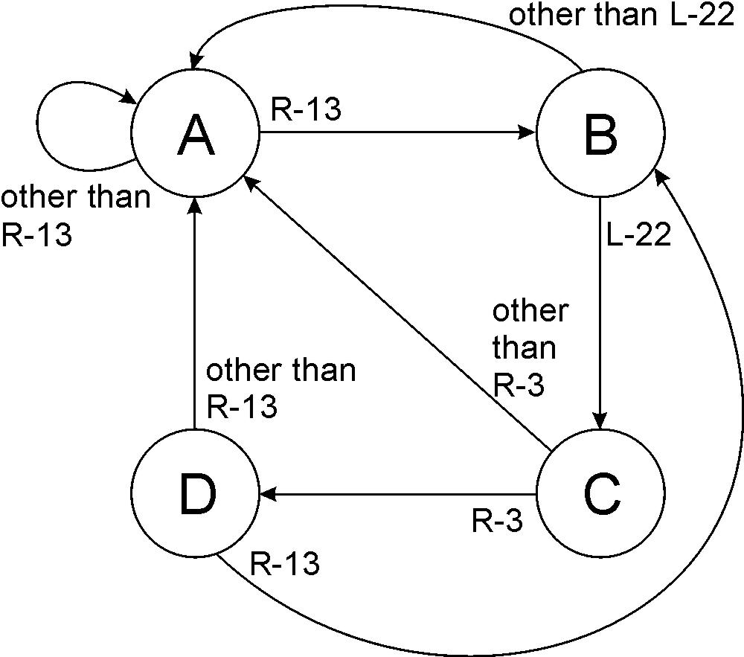
State Diagram
Shows states and actions that cause a transition between states.

Slide 57
Finite State Machine
A description of a system with the following components:
A finite number of states
A finite number of external inputs
A finite number of external outputs
An explicit specification of all state transitions
An explicit specification of what causes each
external output value.
Often described by a state diagram.
  Inputs may cause state transitions.
  Outputs are associated with each state (or with each transition).

Slide 58
Implementing a Finite State Machine
State Machine
Inputs
Combinational
Logic Circuit
Outputs
Storage
Elements
Clock
Combinational logic
  Determine outputs and next state.
Storage elements
  Maintain state representation.

Slide 59
The Clock
“1”
“0”
One
Cycle
time→
Frequently, a clock circuit triggers transition from
one state to the next.
At the beginning of each clock cycle, state machine makes a transition, based on the current state and the external inputs.
  Not always required. In lock example, the input itself triggers a transition.

Slide 60
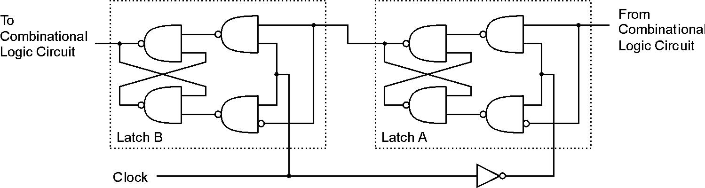
Storage: Master-Slave Flipflop
A pair of gated D-latches,
to isolate next state from current state.
During 1st phase (clock=1),
previously-computed state
becomes current state and is
sent to the logic circuit.
During 2nd phase (clock=0),
next state, computed by
logic circuit, is stored in
Latch A.

Slide 61
Storage
Each master-slave flipflop stores one state bit.
The number of storage elements (flipflops) needed
is determined by the number of states
(and the representation of each state).
Examples:
  Sequential lock
    Four states – two bits
  Basketball scoreboard
    7 bits for each score, 5 bits for minutes, 6 bits for seconds,
    1 bit for possession arrow, 1 bit for half, …

Slide 62
Complete Example
3
4
1
5
2
DANGER
MOVE
RIGHT
A blinking traffic sign
  No lights on
  1 & 2 on
  1, 2, 3, & 4 on
  1, 2, 3, 4, & 5 on
  (repeat as long as switch
  is turned on)

Slide 63
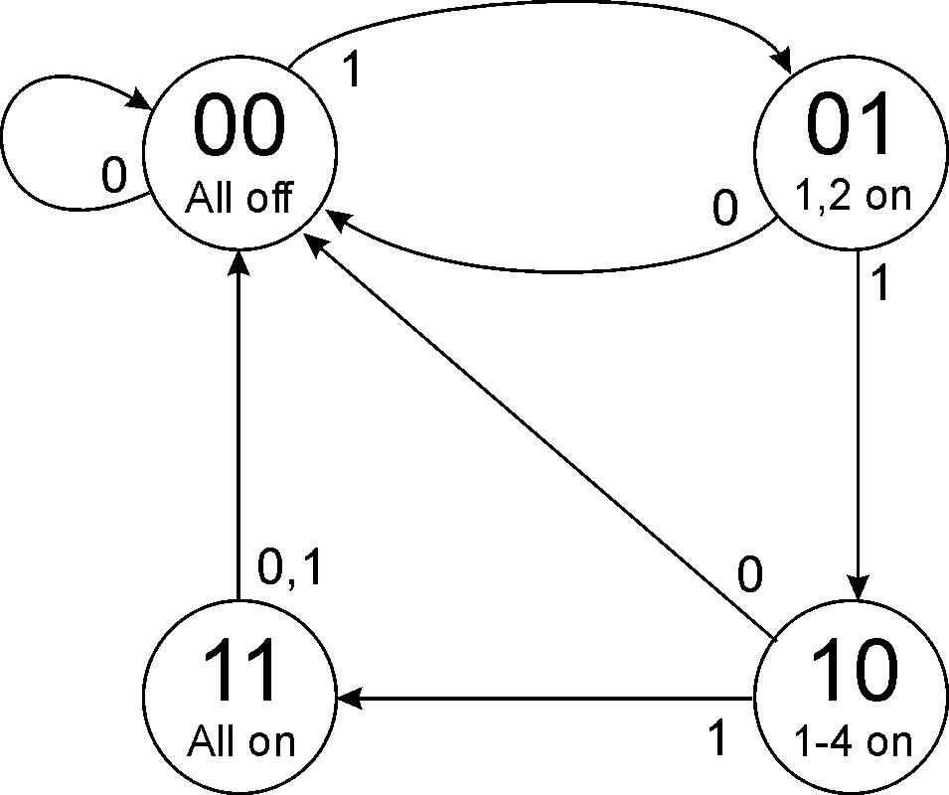
Traffic Sign State Diagram
Switch on
Switch off
State bit S1
State bit S0
Outputs
Transition on each clock cycle.

Slide 64
Traffic Sign State Diagram: State 00
Transition on each clock cycle.

Slide 65
Traffic Sign State Diagram: State 01
Transition on each clock cycle.

Slide 66
Traffic Sign State Diagram: State 10
Transition on each clock cycle.

Slide 67
Traffic Sign State Diagram: State 11
Transition on each clock cycle.

Slide 68
Traffic Sign State Diagram: State 00
Transition on each clock cycle.

Slide 69
Traffic Sign Truth Tables
Outputs
(depend only on state: S1S0)
Next State: S1’S0’
(depend on state and input)
Lights 1 and 2
Switch
Lights 3 and 4
In | S₁ | S₀ | S₁’ | S₀’
0 | X | X | 0 | 0
1 | 0 | 0 | 0 | 1
1 | 0 | 1 | 1 | 0
1 | 1 | 0 | 1 | 1
1 | 1 | 1 | 0 | 0
Light 5
S₁ | S₀ | Z | Y | X
0 | 0 | 0 | 0 | 0
0 | 1 | 1 | 0 | 0
1 | 0 | 1 | 1 | 0
1 | 1 | 1 | 1 | 1
Whenever In=0, next state is 00.

Slide 70
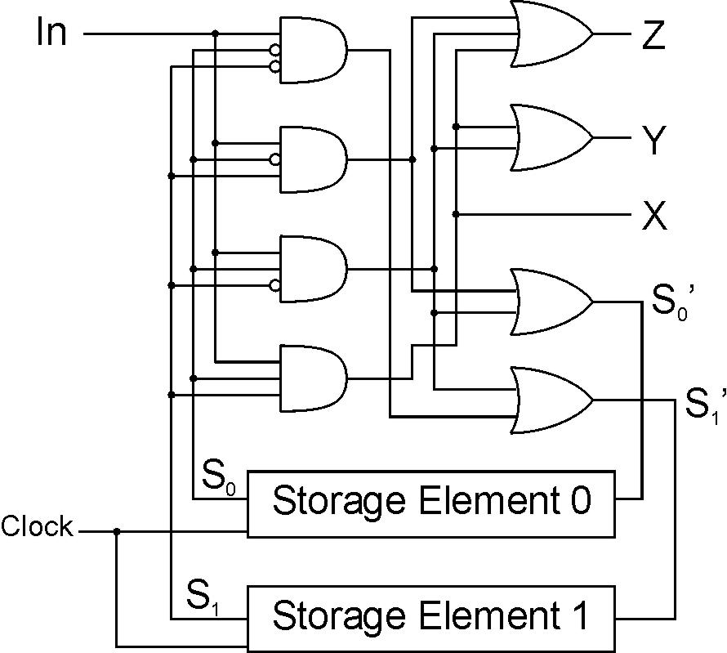
Traffic Sign Logic
S’1
S’0
S1
Master-slave
flipflop
S0

Slide 71
From Logic to Data Path
The data path of a computer is all the logic used to
process information.
  See the data path of the LC-2 on next slide.
Combinational Logic
  Decoders -- convert instructions into control signals
  Multiplexers -- select inputs and outputs
  ALU (Arithmetic and Logic Unit) -- operations on data
Sequential Logic
  State machine -- coordinate control signals and data movement
  Registers and latches -- storage elements

Slide 72
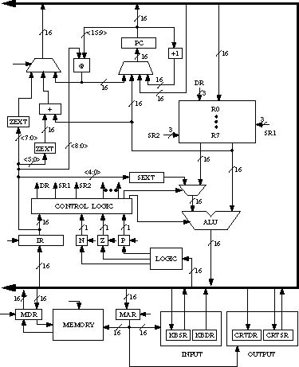
LC-3 Data Path

Slide 73
Summary
MOS transistors are used as switches to implement
logic functions.
  N-type: connect to GND, turn on (with 1) to pull down to 0
  P-type: connect to +2.9V, turn on (with 0) to pull up to 1
Basic gates: NOT, NOR, NAND
  Logic functions are usually expressed with AND, OR, and NOT
Properties of logic gates
  Completeness
    can implement any truth table with AND, OR, NOT
  DeMorgan's Law
    convert AND to OR by inverting inputs and output

Slide 74
Summary
We’ve touched on basic digital logic
  Transistors
  Gates
  Storage (latches, flip-flops, memory)
  State machines
Built some simple circuits
  adder, subtracter, adder/subtracter，Incrementer
  Counter (consisting of register and incrementer)
  Hard-coded traffic sign state machine
  Programmable traffic sign state machine
Up next: a computer as a (simple?) state machine

Slide 75
Next Time
Topic
  The von Neumann Model
Readings
  Chapter 4.0 - 4.2

